Slide 1
Supporting Dementia Family Caregiving: Through A Strengths-based Cultural Perspective Fei Sun (Ph.D., MSW) School of Social Work Michigan State University Town and Gown April 11, 2023

Slide 2
Outline
Background and significance
Understanding dementia family caregiving within a stress and coping framework
Caregiving through a strengths-based cultural lens
Resources and tools for family caregivers

Slide 3
Are you taking or have you taken care of someone with dementia?
Have you received care from someone?
Do you have a friend, relative or know someone who has dementia?
Notes:
You are an expert. Contribute to the knowledge building.

Slide 4
1. Background & Significance
Over 6.7 million persons living with Alzheimer’s disease or related dementia.
About 11 million family members as unpaid caregivers
On average, they provided about 8 hours per day for over 204 days in 2022.
Unpaid dementia caregiving valued at 339.5 billion in 2022
Notes:
2023 Alzheimer's disease facts and figures (wiley.com) 5.4% of total government suspense. Agriculture. Higher than 45% of Medicare expense. ¼ of the social security expenses. 55.7 million.

Slide 5
2. Understanding the needs of older adults with dementia or cognitive impairment

Slide 6
Financial
needs
Medical
needs
Elders with dementia
Daily care needs
Psychosocial needs
National Alzheimer's’ Plan Act in 2011

Slide 7
Needs of Care Recipients
Family Caregivers
Care burden
Economic, Role Conflict, Social Restriction; Emotional distress, Health Impact

Slide 8
The stress and coping model for dementia caregiving
Appraisal
Stressors
Coping strategies
Caregiver health/mental health
Social support
Care recipient needs (e.g. challenging behaviors
Caregiver needs (e.g., work interference; family conflict)
Contextual factors: Demographics, socioeconomic status, and
Values regarding family responsibility; values toward seeking help from others; and beliefs toward dementia

Slide 9
What comprise stressors?
Primary stressors related to the care recipient:
Activities of daily living (e.g., Eating, dressing, transferring)
Instrumental activities of daily living (E.g., managing finances, using transportation, managing medications)

Slide 10
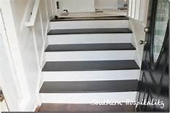

Slide 11
Cognitive and social wellbeing ---remaining cognitive stimulated, and social participation
Behavioral and psychological problems
(e.g.,
Wandering
Agitation
Suspicion
Aggression
Hallucinations)

Slide 12
https://youtu.be/dXhgX_3oaVc?t=54

Slide 13
Secondary stressors
Financial cost
Role conflict
Family relations
Social restrictions
Emotional distress (e.g., guilt, embarrassment, anger, hopelessness, grief）

Slide 14
3. Through a strengths-based cultural perspectives What are positive sides of caregiving?

Slide 15
1. Strengthening relationship with the CR
2. Satisfaction with the care given to the CR
3. Personal growth
4. Increased meaning and purpose in one’s life
5. Good role modeling for one’s own children
6. Learned something new
7. Have wonderful moments of joy and laughter
….

Slide 16
https://youtu.be/dXhgX_3oaVc?t=270

Slide 17
Through a cultural perspective: Family values toward elder care
孝顺 in Chinese
Utang na loob in Filipino
Oya-koko in Japanese
효 in Korean
bakti in Bahasa Indonesia
lòng hiếu thảo in Vietnamese
Familism in Latinos
Strong intergenerational support among African American families

Slide 18
The stress and coping model for dementia caregiving
Appraisal
Stressors
Coping strategies
Caregiver health/mental health
Social support

Slide 19
_
Appraisal
More caregiving tasks
X
Higher responsibility on oneself toward elder care
Coping and Support
Lower levels of perceived bother
Higher threshold to generate positive reward of caregiving

Slide 20
_
Appraisal
Fewer caregiving tasks
X
Coping and support
Lower responsibility
Higher perceived bother
Lower threshold for positive appraisal of caregiving

Slide 21
4. Implications for caregivers
Self-assessment of your strengths and needs along
three domains:
Appraisal & Coping & Social Support

Slide 22
Appraisal, Coping and Support
1) In general, do you have realistic expectations on yourself as a caregiver? Are you able to see positive sides of caregiving?
2) In times of difficulties, how do you generally cope?
Problem-focused vs. emotion-based coping
Proactive coping vs. denial/avoidance
3) Where do you draw on strengths or help to deal with difficult situations?
Personality, spirituality and cultural values (e.g., filial piety, diet, rituals)

Slide 23
Common needs among Dementia Family Caregivers
More knowledge and education about ADRD/dementia regarding diagnosis, treatment, and care.
Assistance with concrete needs (e.g., assistance with ADL tasks; transportation to doctor visits; care planning; financial and legal assistance)
Respite care for caregivers
Access to culturally relevant and adapted services and support for care recipients and caregivers
(e.g., services addressing language barriers, food/music preference,)

Slide 24
Available community supports and resources
In-home support for the care recipient
Information and referral (transition to care facilities, legal, financial issues)
Respite care
Caregiver consultation/training on care planning, dementia knowledge, stress reeducation, and caregiving skills training.
f. Counseling

Slide 25
Local & online resources
Caregiver Support | Tri-County Office on Aging (tcoa.org)
Dementia consultation (KC Austern at 517-887-1418.
Caregiver workshops and classes
MSU Dementia Care Support Lab
a. Online caregiver support (information, problem solving) via Trualta
b. Counseling via PISTA
Michigan Dementia Coalition website: Michigan Dementia Coalition - Resources (midementiacoalition.org)

Slide 26
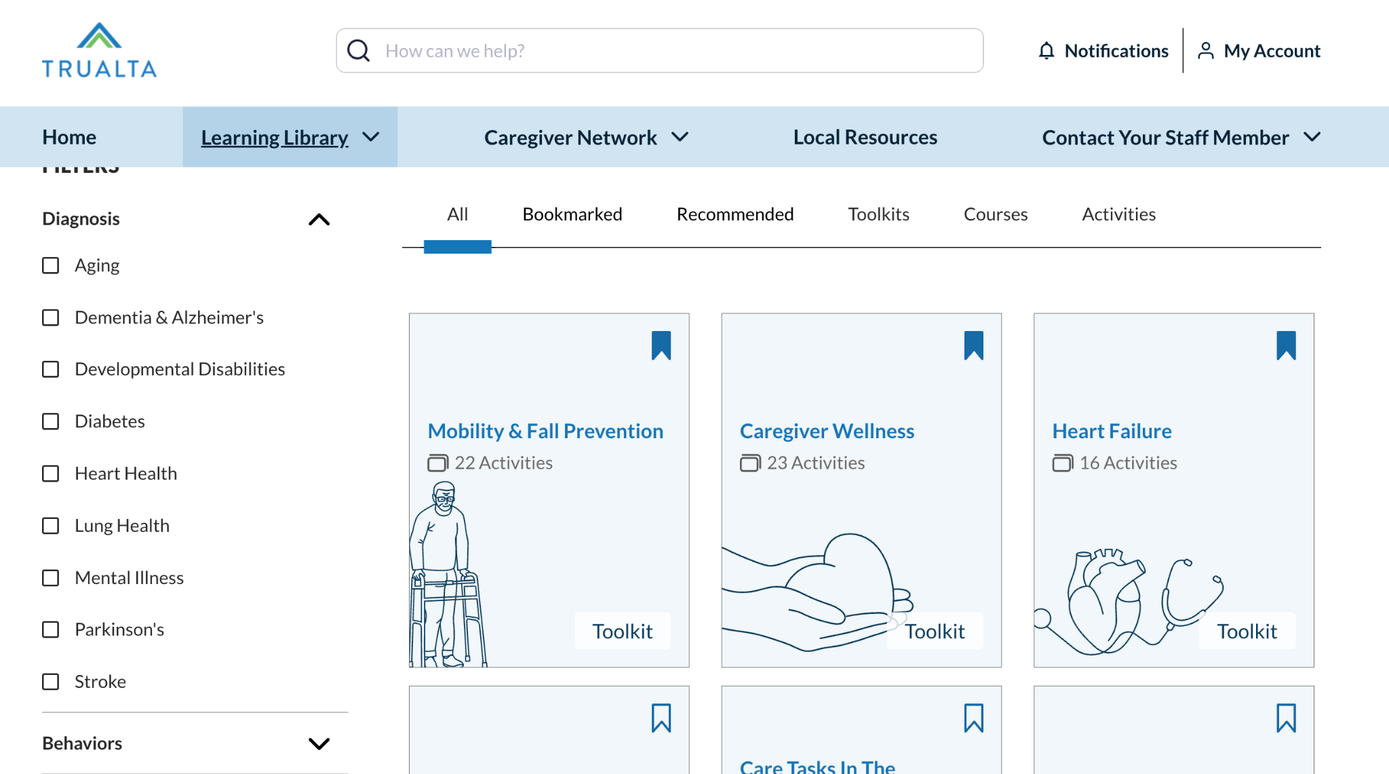
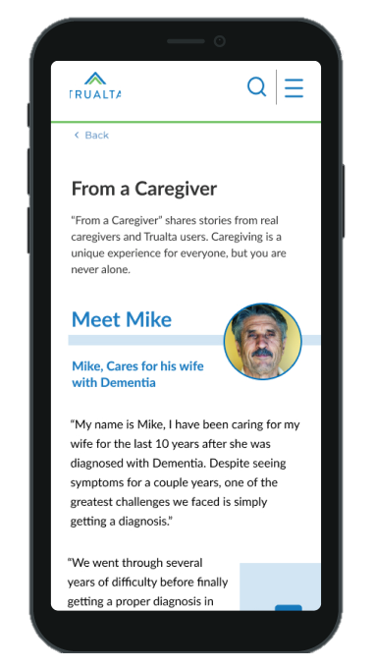
Trualta helps caregivers learn skills to manage care, provided for FREE by Region 9 AAA and MSU-SSW
Caregivers can register today to access an interactive eLearning environment
Short, quick lessons created by experts in aging
Easy to use for all ages, completely private, and accessible 24/7
No app required, view on any browser, computer, laptop, phone or tablet
Social features, like virtual support groups

Slide 27
PISTA (Processing inner strengths toward actualization)
Using binaural beats to help address anxiety and negative feelings and improve insight and confidence
Notes:
Nuts is healthy for your brain; by Omega-3 fatty acids, （noun saturated） vitamins, minerals and antioxidants.

Slide 28
Takeaways
Dementia caregiving is stressful but can be rewarding
Cultural values provide strengths and can pose threats to caregiver health and mental health outcomes.
Pay attention to your own self-care by assessing your Appraisal, Coping and Support.
Seek right help that aligns well with your personal and cultural preferences.

Slide 29
Thank you ! sunfei@msu.edu

